Slide 1

Assembly Language Programming: 1. Introduction
Prepared by:
Md. Jahidul Islam (Lecturer, Dept. of CSE, UIU.)
Special Thanks to:
Muhammad Tasnim Mohiuddin (Lecturer, Dept. of CSE, UIU.)
April 2015.
Department of Computer Science & Engineering (CSE), United International University (UIU).

Slide 2
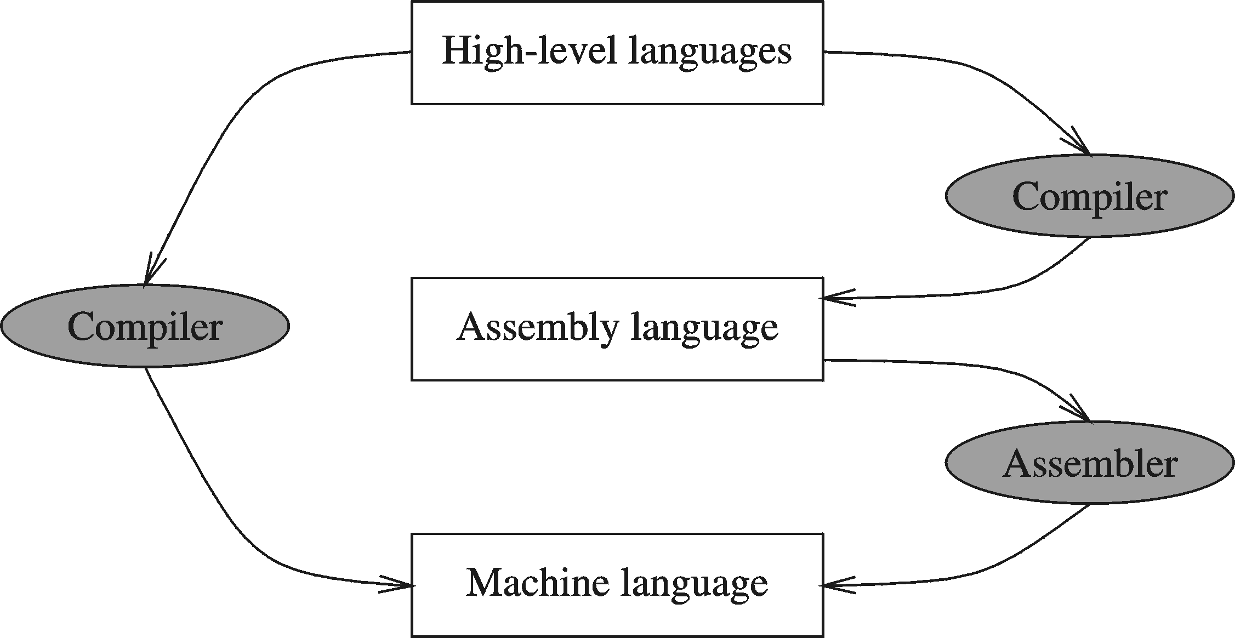
Programming Languages
Machine Language
Assembly Language (Low Level Language)
High Level Languages
April 2015.
Department of Computer Science & Engineering (CSE), United International University (UIU).

Slide 3
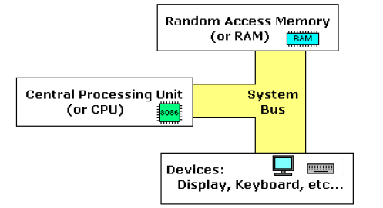
Simple Computer Model
April 2015.
Department of Computer Science & Engineering (CSE), United International University (UIU).

Slide 4
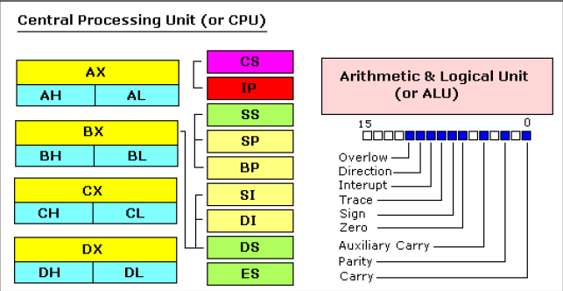
Inside the CPU
April 2015.
Department of Computer Science & Engineering (CSE), United International University (UIU).

Slide 5
CPU Registers
General purpose registers
Segment registers
Instruction Pointer
Flags register
Special purpose registers
Debug registers
Machine Control registers
April 2015.
Department of Computer Science & Engineering (CSE), United International University (UIU).

Slide 6
General Purpose Registers
AX (accumulator register):
Stores operands for arithmetic & data transfer instructions.
BX Register (base register):
Holds the starting base address of a memory within a data segment.
CX Register (counter register):
Primarily used in loop instruction to store loop counter.
DX Register (data register)
Used to contain I/O port address for I/O instruction.

Slide 7
General Purpose Registers (contd.)
Each of these 16-bit registers are further subdivided into two 8-bit registers.
AX
BX
CX
DX
AH | AL
BH | BL
CH | CL
DH | DL

Slide 8
Memory Segmentation
Data Segment
contains variable definitions
declared by .DATA
Stack segment
used to store the stack
declared by .STACK size
default stack size is 1KB.
Code segment
contains program’s instructions
declared by .CODE
Extra segment
ES
64 KB
SS
64 KB
CS
64 KB
DS
64 KB
8086 Memory

Slide 9
Flag Register
Flag register determines the current status of the microprocessor.
It is modified automatically by CPU after mathematical operations.
This allows to determine the type of the result.
8086 has 16-bit Flag register.
There are two kinds of flags: Status Flags and Control Flags

Slide 10
Flag Register (contd.)
Status Flags | Control Flags
Carry Flag (CF) | Trap Flag
Auxiliary-carry Flag (AF) | Interrupt Flag
Zero Flag (ZF) | Directional Flag
Sign Flag (SF)
Parity Flag (PF)
Overflow Flag (OF)

Slide 11
Flag Register (contd.)
Flag | Purpose
Carry (CF) | CF = 1 if there is a carry out from the MSB on addition or there is a Borrow into the MSB on subtraction.
Parity (PF) | PF=1 if the low byte of a result has an even number of one bits (even parity).
Auxiliary (AF) | Holds the carry (half–carry) after addition or borrow after subtraction between bit positions 3 and 4 of the result (for example, in BCD addition or subtraction.)
Zero (ZF) | Shows the result of the arithmetic or logic operation. Z=1; result is zero. Z=0; The result is 0
Sign (SF) | Holds the sign of the result after an arithmetic/logic instruction execution. SF=1 if the MSB of a result is 1.

Slide 12
Flag Register (contd.)
Flag | Purpose
Trap (TF) | Enables the trapping through an on-chip debugging feature.
Interrupt (IF) | Controls the operation of the INTR (interrupt request) IF = 0 if the INTR pin is disabled IF = 1, if the INTR pin isenabled.
Direction (DF) | Selects either the increment or decrement mode for DI and /or SI registers during the string instructions.
Overflow (OF) | Overflow occurs when signed numbers are added or subtracted. An overflow indicates the result has exceeded the capacity of the machine.

Slide 13
Pointer and Index Registers
Stack Pointer (SP)
A 16-bit register pointing to program stack
Base Pointer (BP)
A 16-bit register used to access data in stack segment
Usually used for based indexed or register indirect addressing
Source Index (SI) & Destination Index (DI)
16-bit registers
Used to point to memory locations in the data segment

Slide 14
Any Questions?
Thank You
April ,2015.
Department of Computer Science & Engineering (CSE), United International University (UIU).

